Slide 1
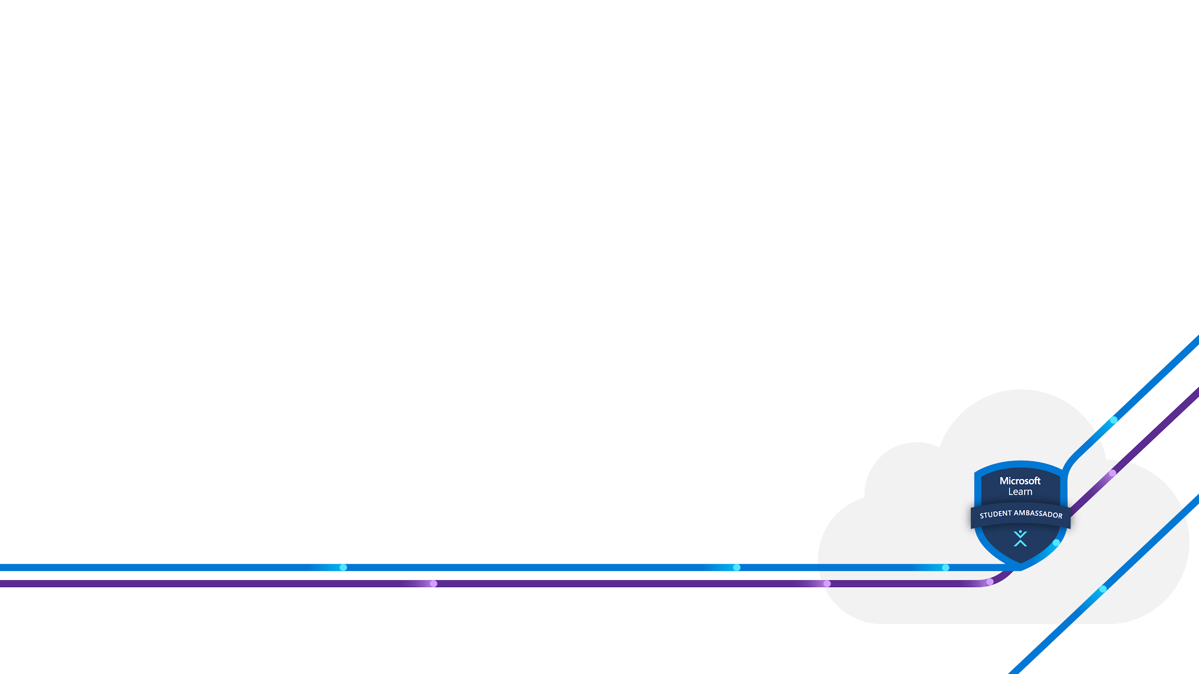

Getting Started with Microsoft Azure for Machine Learning
Presented By:
Michael Adetoro
A workshop on how to use Microsoft Azure for machine learning

Slide 2
Session Walkthrough
Overview of Machine Learning with Microsoft Azure
Some Basic Terminologies in Azure (Azure ML)
Setting Up Azure Account
Workshop

Slide 3
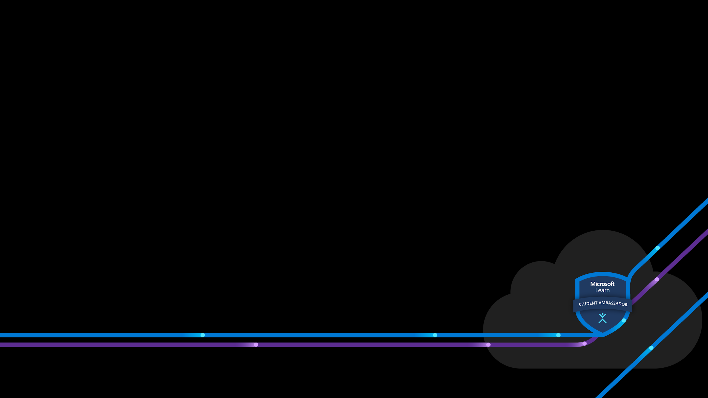
Overview of Machine Learning with Microsoft Azure
Introduction to Azure
Introduction to Machine Learning
Machine Learning with Microsoft Azure
Azure Benefits for Machine Learning

Slide 4
Introduction to Azure
Azure is a public cloud computing platform and service provided by Microsoft.
It allows businesses and organizations to build, deploy, and manage their applications and services in the cloud for free or on pay-per-use, on-demand basis.
There are 200+ products and services available in the platform.

Slide 5
Introduction to Machine Learning
Machine learning is a field of artificial intelligence that uses statistical techniques to enable computers to learn and make decisions without being explicitly programmed.
In simple terms, machine learning involves training computers to learn from data, like how you learn from experience, so they can make predictions on their own.

Slide 6
Types of Machine Learning
Supervised Learning: This involves training an ML model on a labeled dataset, where the inputs and outputs are known.
Unsupervised Learning: This involves training an ML model on an unlabeled dataset, where the inputs are unknown.
Semi-Supervised Learning: This is a combination of supervised and unsupervised learning, where the model is trained on both labeled and unlabeled data.

Slide 7
Types of Machine Learning (Cont’d)
Reinforcement Learning: This involves training an ML model to interact with an environment and learn from the feedback it receives. The model learns to take actions that maximize a reward signal based on the feedback it receives.
Transfer Learning, Deep Learning.
NB: Regression task (which is a type of supervised learning) is our focus for this workshop.

Slide 8
Machine Learning with Microsoft Azure
To use Azure for Machine Learning, there are 3 major ways to go about it:
Notebook: Writing codes for every of your machine tasks.
Automated ML: Use pre-trained model for your machine learning tasks.
Designer: Use of drag and drop. No-code

Slide 9
Azure Benefits for Machine Learning
Easy to use
Scalability
Automatic Machine Learning
Flexible
Cost-effective
Integration with other Azure Services like Azure Data Lake and Azure Stream Analytics.
Etc.

Slide 10
Some Basic Terminologies in Azure (Azure ML)
Workspace - a container for all resources and artifacts associated with a machine learning project
Experiment - a named set of steps in a machine learning workflow
Compute - the resources used to run machine learning workloads
Dataset - a collection of data that can be used for machine learning
Model - the output of a machine learning algorithm used to make predictions or decisions
Pipeline - a series of interconnected steps in a machine learning workflow

Slide 11
Some Basic Terminologies in Azure (Azure ML) (Cont’d)
Experiment Run - an instance of running an experiment
Compute Instance - a fully managed and scalable cloud-based machine learning environment
Deployment - the process of making a machine learning model available for use in production
AutoML - a service that automatically trains and tunes machine learning models
Data Asset - any data used or generated during a machine learning workflow
Data Store - a storage location for data assets, linked to various types of storage services

Slide 12
Setting up Azure Account
Creating an Azure account
Go to this url: https://azure.microsoft.com/en-us or search Microsoft azure on your browser to create an account.
You can access the student benefit by clicking on the Access student benefits OR,
By going to this url: https://azure.microsoft.com/en-us/free/students/ or searching Azure for Students on your browser.

Slide 13
Workshop
Search for Azure Machine Learning service.
Create a Workspace.
Go to the Microsoft Azure Machine Learning Studio.
Select Automated ML in the Authoring section.
Let’s go.

Slide 14
Data: https://www.kaggle.com/datasets/rishidamarla/heart-disease-prediction
Courses There are available beginner courses for you on Microsoft Learn platform
Microsoft Azure AI Fundamentals: Get started with artificial intelligence
Azure Machine Learning
Etc.

Slide 15
Thank you for your time and attention.
LinkedIn: Michael Adetoro
Twitter: @_michaeladetoro
Meeting Link: https://bit.ly/gsmaML

